Slide 1
The Rise of the Machines
by Roy van de Water

Slide 2
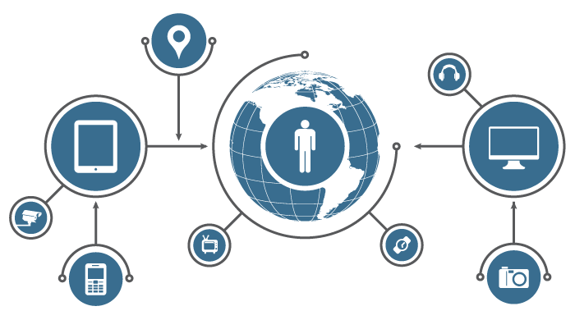
What is the
Internet of Things?

Slide 3
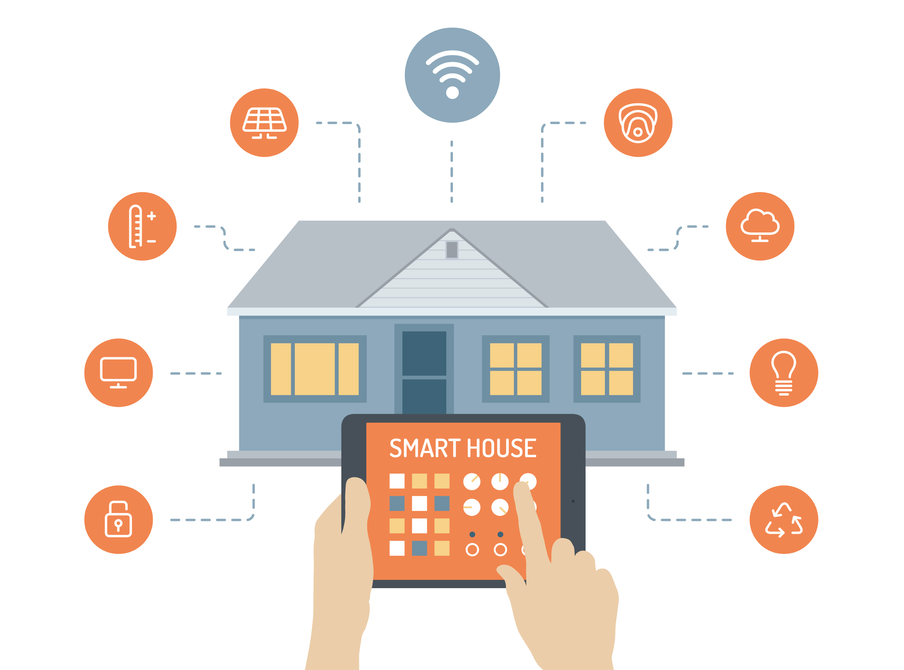
Smart Devices, Connected to Everything

Slide 4
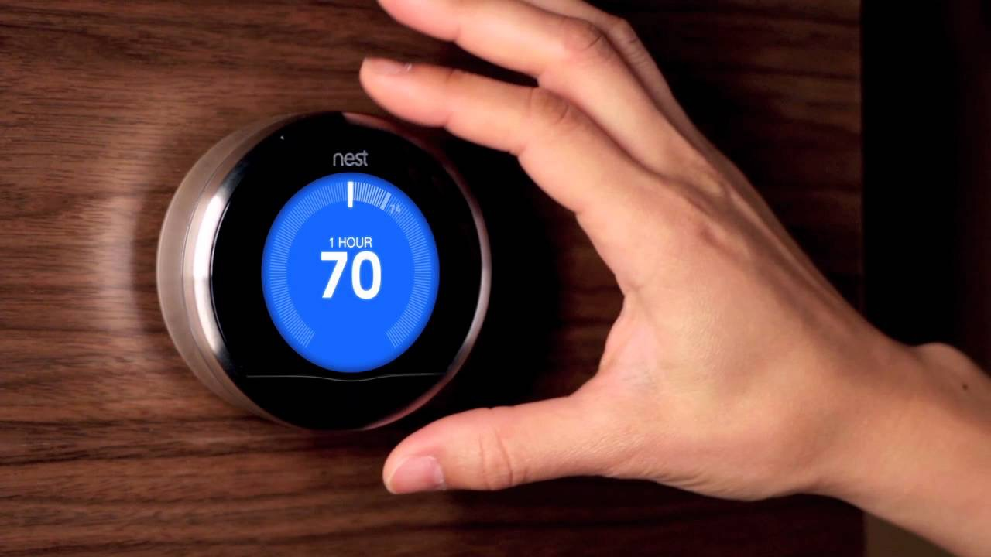

Slide 5
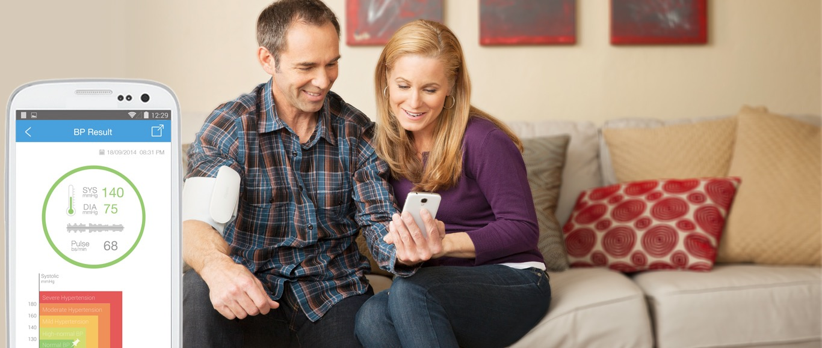

Slide 6
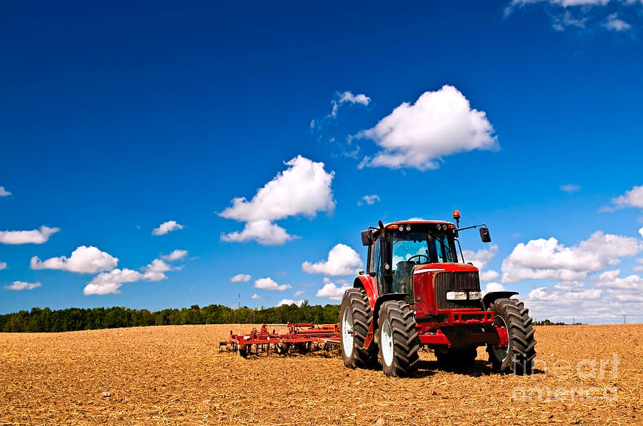

Slide 7
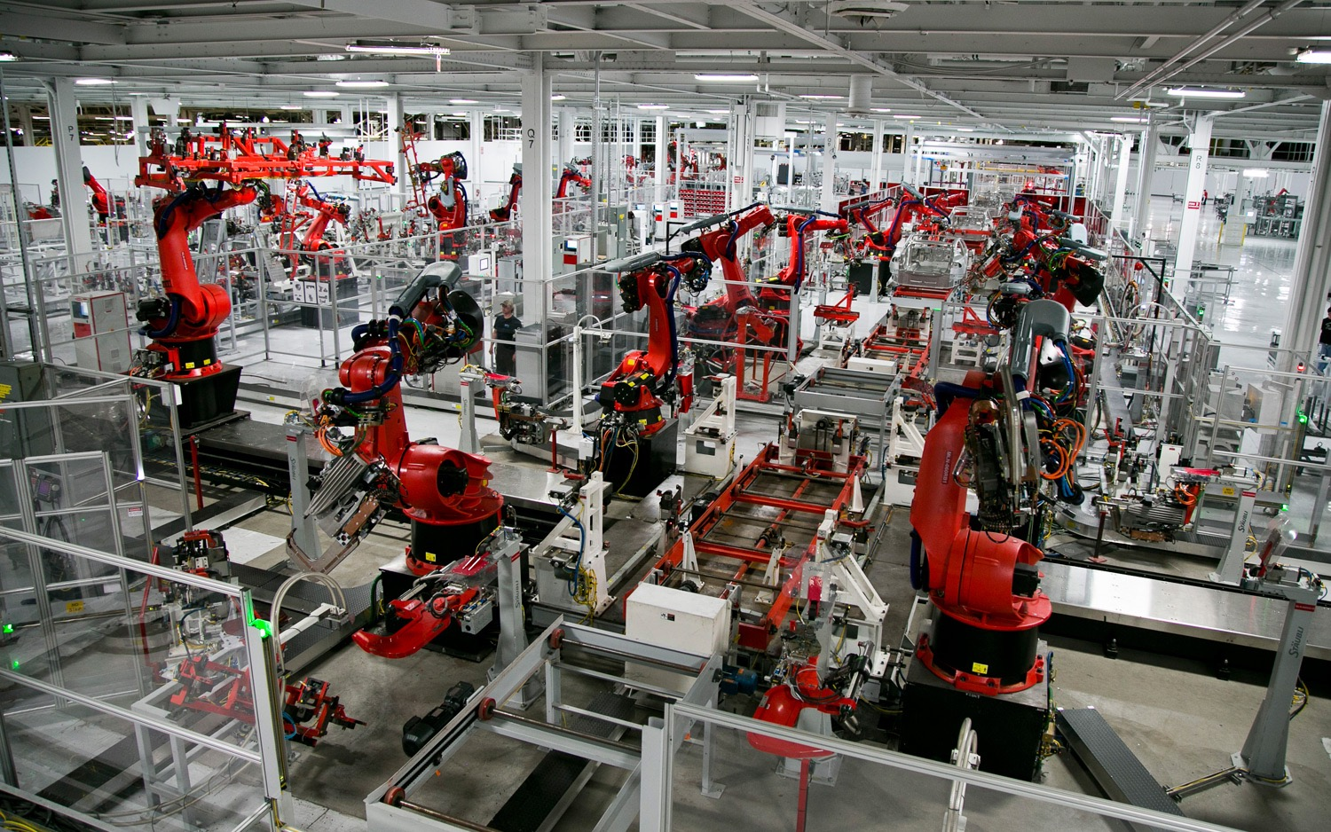

Slide 8
“The Internet of Things has the potential to change the world, just as the internet did. Maybe even more so.”
~ Kevin Ashton

Slide 9
Today: 1.9B connected devices.
50B estimated by 2020.

Slide 10
By 2020, the IoT market value is predicted to be between $3T and $14T

Slide 11
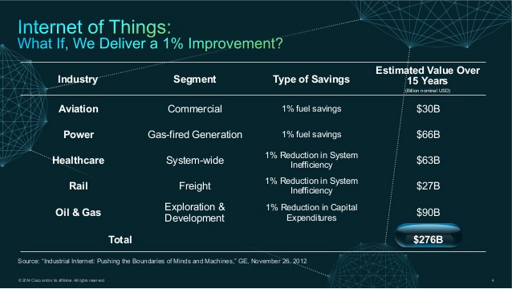

Slide 12
IoT & Business Automation

Slide 13
“Everything that can be automated, will be automated.”
~ Robert Cannon

Slide 14
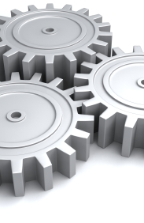
Automation
Let machines do the hard work

Slide 15
“We are going to be completely unemployed as muscle-working machines”
~ Buckminster Fuller

Slide 16
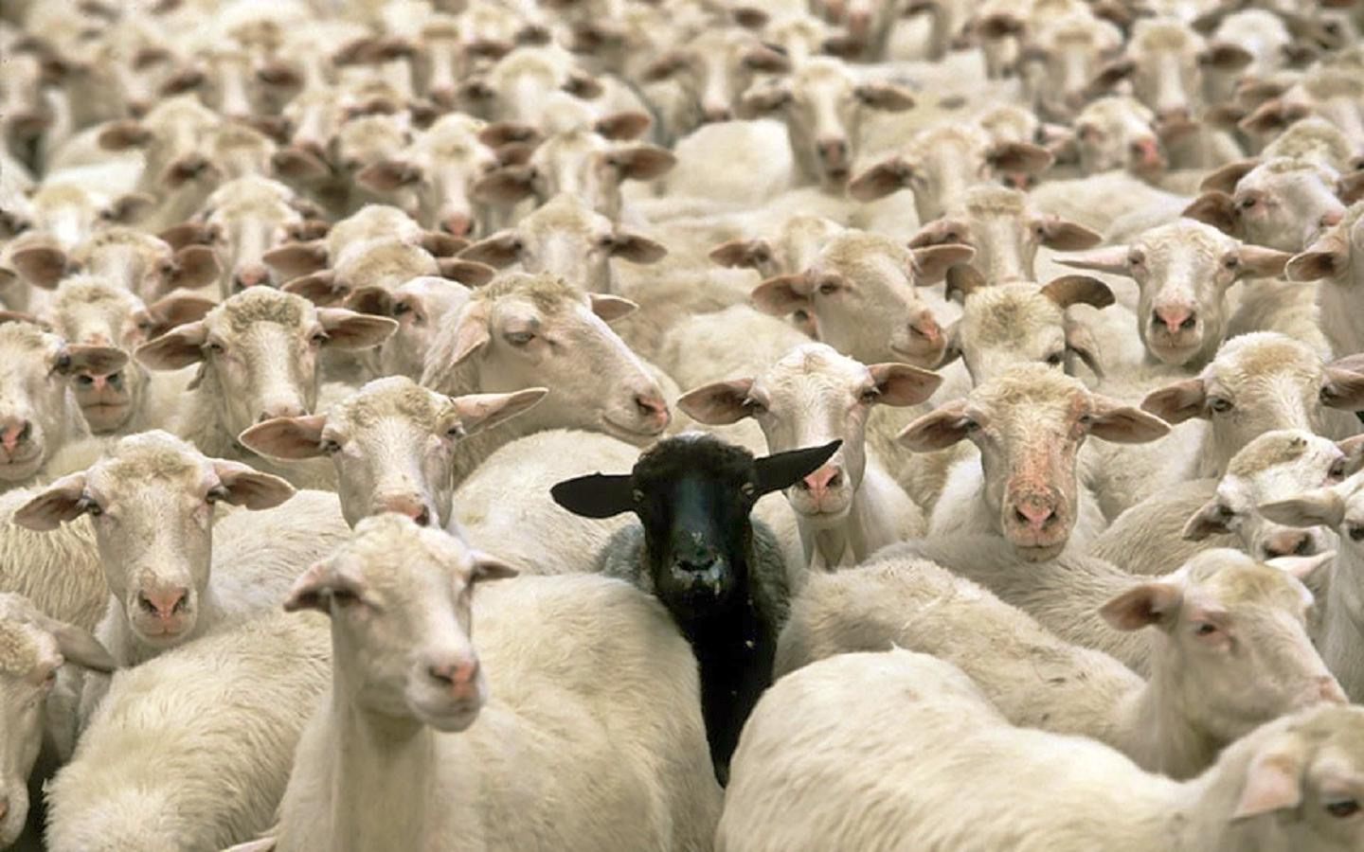
Machine Learning
Anomaly detection

Slide 17
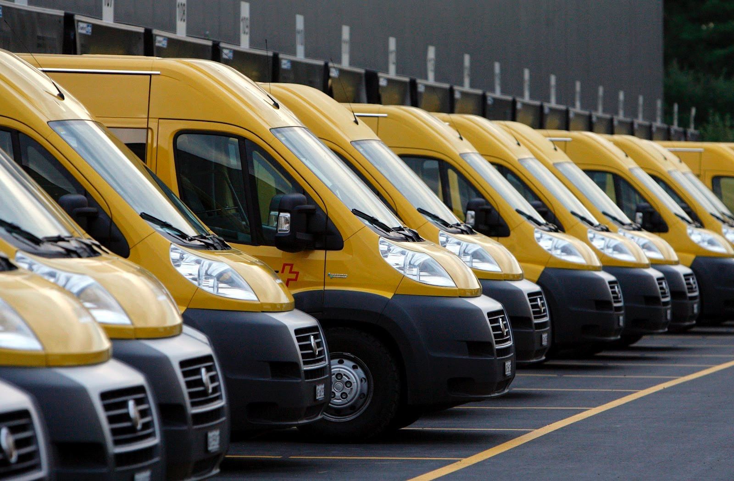
Machine Learning
Event prediction

Slide 18
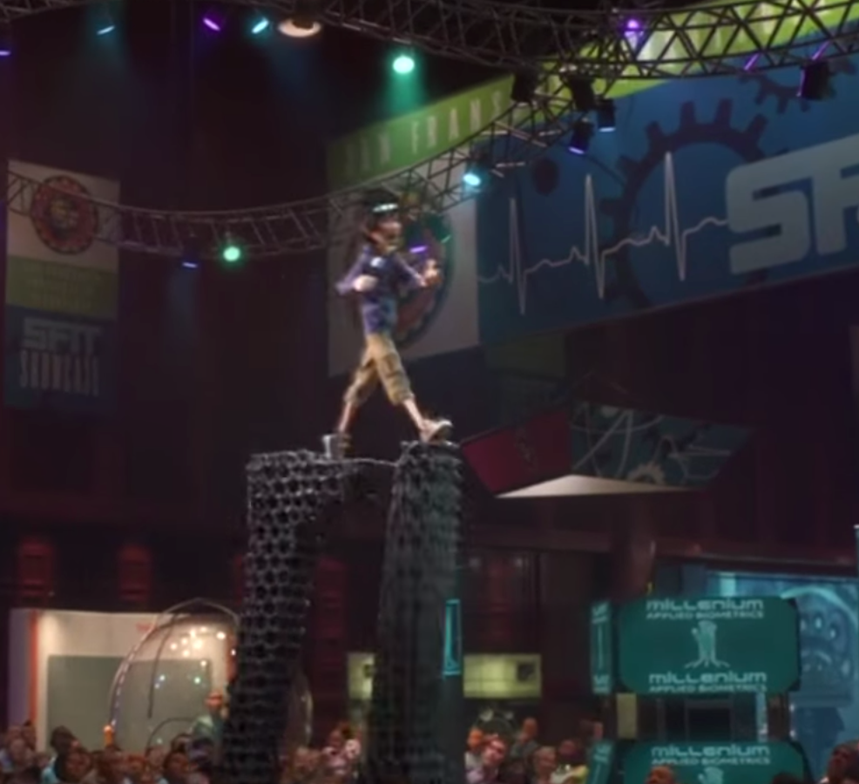
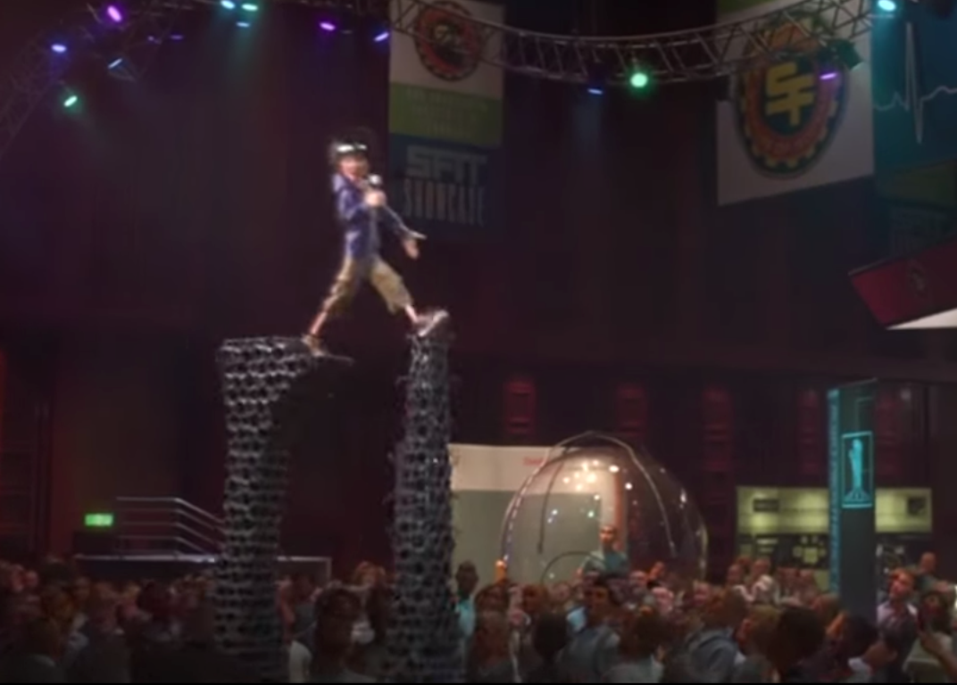
Machine Learning
Context aware systems

Slide 19
Where do humans fit in?

Slide 20
Human Interaction
Humans have the power of personality and creativity, automate the rest.

Slide 21
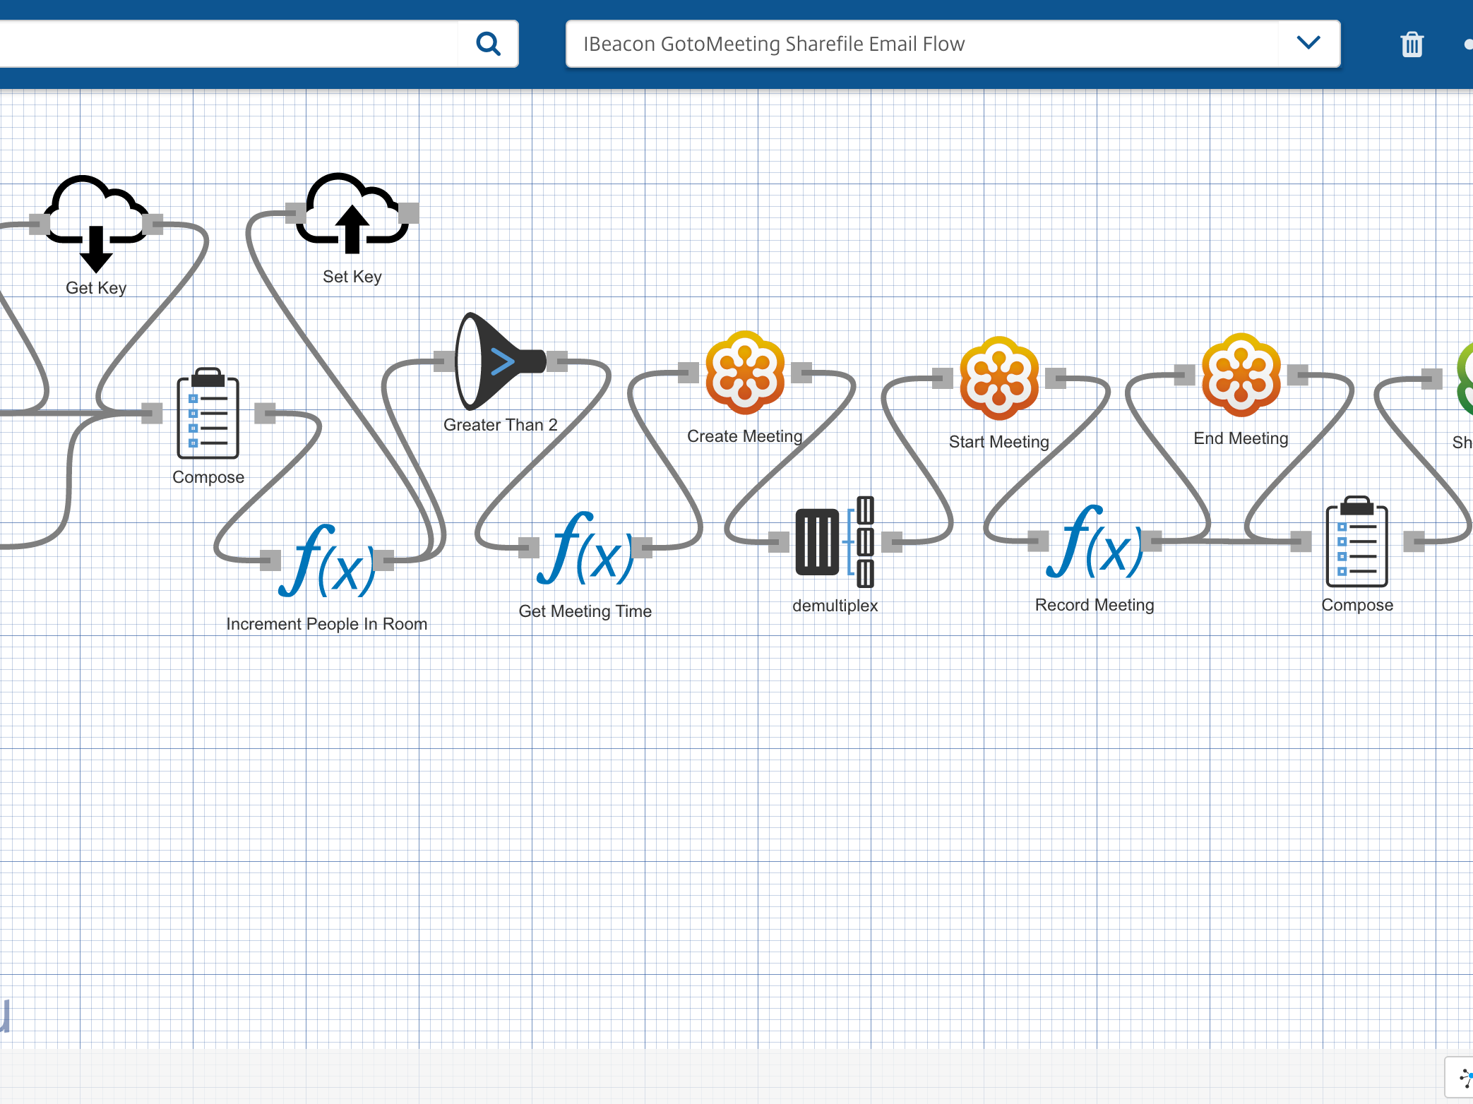

Octoblu
The Internet of Things operating system

Slide 22
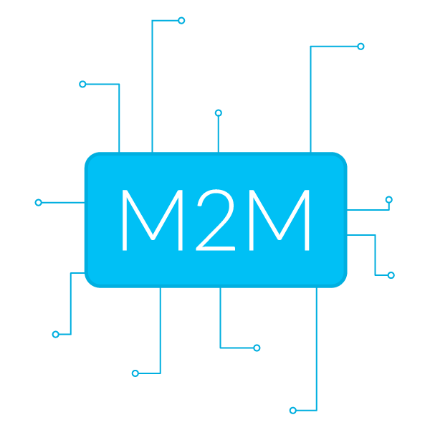
Talking to devices is hard, we make it easy

Slide 23
How to IoT

Slide 24
Be Lazy

Slide 25
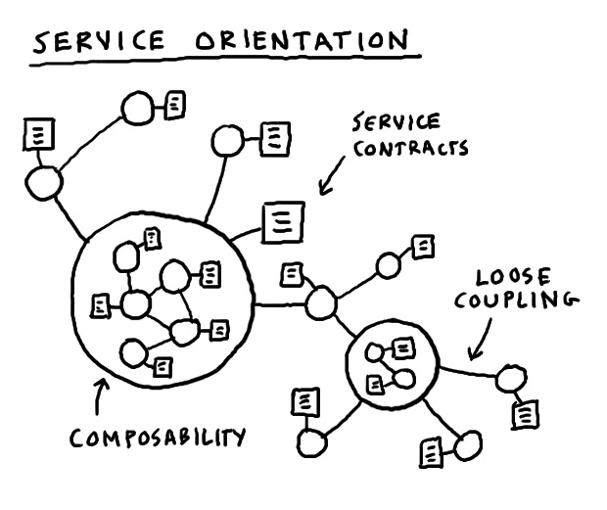
Microservices
Complex applications written in small independent programs

Slide 26
Machines cost far less than humans

Slide 27
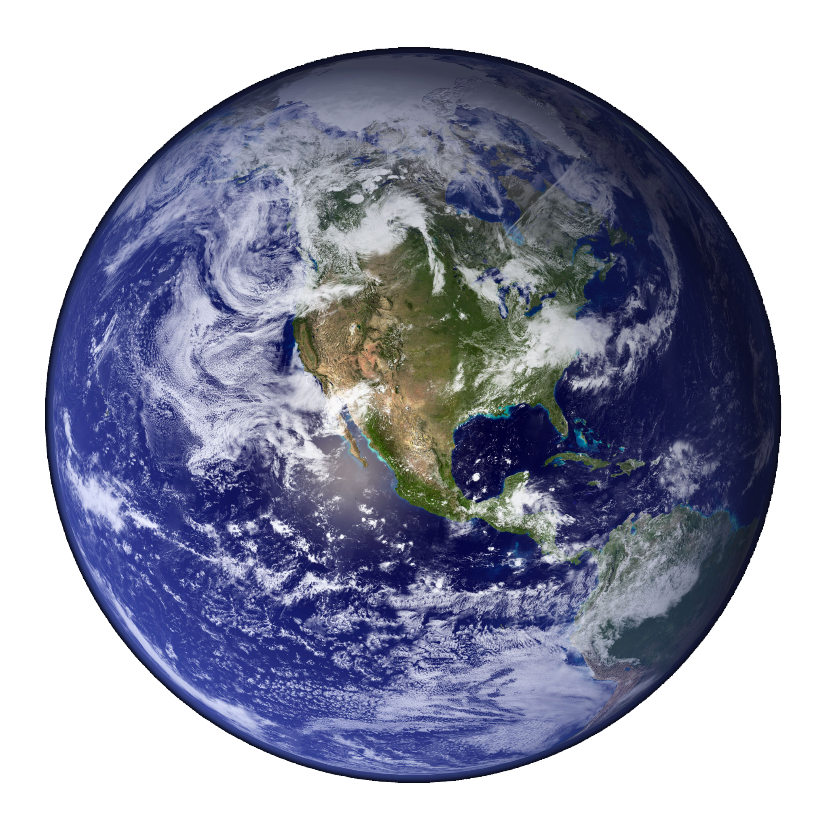
Make the world a better place

Slide 28
Roy van de Water
UUID: ~69286630-0862-11e4-b1c7-4f6f6e31e7b4
Twitter: @royvandewater
Email: r@octoblu.com
Slide Deck available at
https://github.com/royvandewater/rise-of-the-machines-talk/

